Slide 1
Welcome to the IT Learning Centre
You are in the right place …
We’ll be starting soon

Slide 2
R: A First Look
Srinivasa Rao
sraorao.netlify.app

Slide 3
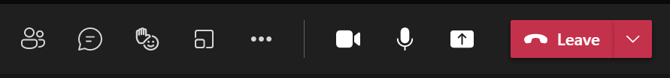


Ready To Learn?
Today’s session takes place in a video-call using Teams
You can turn on Live Captions using
♫♪
Don’t plan to multi-task
Notes:
Use this slide for workshops held online
Give them ways to communicate with you
– speak up with a mic, raise your hand, or chat in the meeting (shared) or chat directly to the teacher (private)

Slide 4
Today’s resources
How will you display your workbook?
Where are your course files?
Is the software installed?
♫♪
Notes:
Use this slide for workshops held online
Get them to check:
Have they got the right software, does it work?
They were asked to download the course workbook, probably as a PDF
Have they got that printed, or on another device, or on their main device switching windows
They were asked to download the work files for hands-on activities, probably in a ZIP folder
Did they save them somewhere sensible such as their Desktop?
Have they Extracted the Zip?
(many files pretend to work directly from inside a Zip but they don’t work properly so you do need to do the Extract All step)

Slide 5
What is R and what can you use it for?
A statistical programming language
Can be used for non-statistical programming too
Great for specific domains due to code repositories (CRAN, Bioconductor)
Great for visualisation
Versions and packaging are highly streamlined
When to use other languages (e.g. Python)?
When speed and memory usage are considerations (but we are talking millions of data points!)
Image/video analysis

Slide 6
What is RStudio?
An Integrated Development Environment (IDE) for R
Not necessary, but makes coding much easier!
Tools to visualise data, R objects, help files, etc.
Helps organise R files into "Projects"
Additional tools for reporting (R Markdown), building websites, integration with git (version control)
RStudio Cloud: An online version of RStudio, for teaching, collaborative projects -> we will use this today

Slide 7
1-Intro The basics
On the first worksheet, we’ll:
Study the basics of R
Learn how to carry out arithmetical calculations
Store values as variables
Learn what vectors are and how to work with them

Slide 8
2-Data management
On the second worksheet, we’ll:
Learn about data frames and import one
Select columns and rows of a data frame
Filter data by its values

Slide 9
3-Data analysis and visualisation
On the third worksheet, we’ll:
Learn some exploratory data analysis methods using R
Make simple plots
(Optionally) Fit linear models and plot lines of best fit

Slide 10
4-Data reporting
On the fourth worksheet, we’ll:
Comment some pre-written code
(Optionally) Look at an R Markdown document

Slide 11
5-Tidyverse
On the fifth worksheet, we’ll:
Learn what packages are, and load one
Use pipes to chain up functions
Use tidyverse packages to manipulate data and make plots

Slide 12
Continue to learn R...
Install swirl and type swirl() into the R console
Other courses offered by
IT Services - R: Hands-on with using R for data analysis
Medical Sciences Division: Intro to R for Biologists
LinkedIn Learning: R for data science (free through Oxford institutional subscription, needs SSO)
Free online book: R for Data Science (also available to purchase in paper copy)
Google!

Slide 13
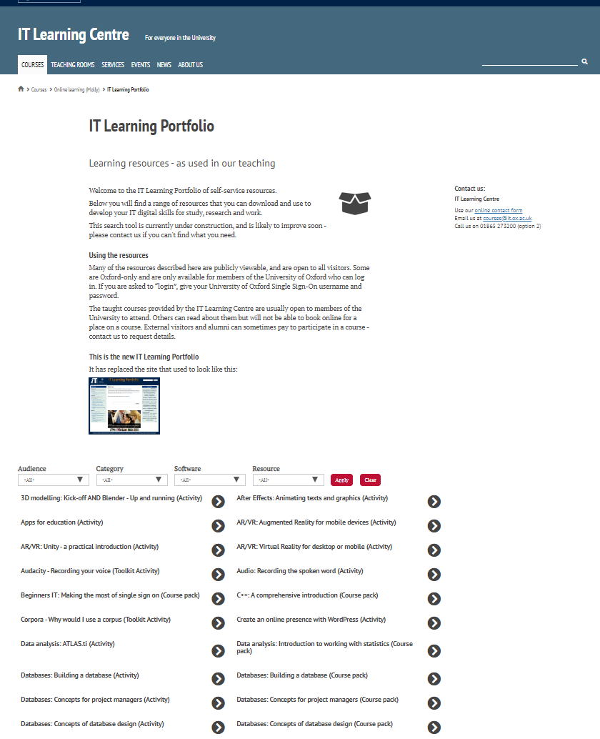

Find the resources for the workshop in our IT Learning Portfolio
Download the files (and more) from the IT Learning Portfolio at
skills.it.ox.ac.uk/it-learning-portfolio

Slide 14


Resources for your learning
Activities for you to practice today
In the course handbook
Work at your own pace!
Be selective
Videos with today’s topics in Molly
Follow-up work
Continue with exercises after the session
Bookable Course Clinics later
Notes:
The exercises: we set up some scenarios for you to explore, to try out the topics we are demonstrating. The emphasis is on you discovering what works best for you and your own work.
You were asked to download the course workbook (probably as a PDF) and save it somewhere convenient – Now please open it or find it, you will need it
Or
You have been given a printed workbook
How-to videos – I hope you have looked at the videos that I recommended – you will need that knowledge to do today’s exercises. For a refresher, the video activity can be found in the IT Learning Portfolio (search for today’s course title).
Repeat the exercises later for practice, or to work further on topics that interest you.
Come and see me again at a Course Clinic, email courses@it.ox.ac.uk to book a slot.

Slide 15

Acknowledgements
This presentation is made available by Srinivasa Rao under a Creative Commons licence: Attribution-NonCommercial-ShareAlike CC BY-NC-SA
[srinivasa.rao@nds.ox.ac.uk]

